Slide 1
Energy and climate –
a major policy challange
Asgeir Tomasgard
Professor Norwegian University of science and technology, Dept. of industrial economics
Director, FME CenSES
Centre for Sustainable Energy Studies

Slide 2
EU climate policy

Slide 3

EUROPEAN CLIMATE POLICY
EU’s goal is to cut the yearly greenhouse gas emissions with 40% by 2030 compared with the 1990 emissions level.
Signaled ambissions: 80-95% before 2050
One of the most important policy instruments is the quota system for CO₂ emissions, the EU Emission Trading System (EU ETS).

Slide 4
EU ETS
Today, about 45% of the emissions are regulated by ETS. This means that if you are going to generate CO₂ emissions in a sector that is regulated by ETS, you have to buy an emission permission (EU allowance).
In order to reach the reduction goals, the emission persmissions that are auctioned out each year, will be reduced by 2.2% yearly from 2021, while they until 2020 will be reduced by 1.74% yearly.
Companies in the power sector and other sectors buy permissions for each tonn of CO₂ emissions.
Make your production without CO₂ emissions, or buy permissions!

Slide 5
EU ETS
Permissions can be saved between from one year to another, so the pricing is a bit more complicated, since future technologies and emission need are also being considered.
CO₂-prices and quota prices are considered as cost efficient ways to reach the climate emissions cuts.
For sectors within EU ETS, the 2030 GHG emission cuts will be around 43%, while the corresponding number for sectors outside is 30%. EU ETS is technology neutral.

Slide 6
202020 policy
More than ETS – EU has a diversified climate policy.
The energy system is a driving force for all development in the modern society, and a prerequisite for future welfare.
Emission reduction is one out of many and often competing goals in the process that should lead up to a new energy system:
Economic growth
Energy security
CO₂ emissions
Environment

Slide 7
202020-politikken
The main goals in EU’s strategy towards 2020 are:
20% reduction of greenhous gas emissions from the 1990 level.
20% increase in the share of consumption from renewable energy production.
20% increase in energy efficiency.
This strategy is probably as much motivated by the wish for energy security, economic growth, improvement of local environment and long-term technology stimulation, as it is motivated by climate gas reductions.

Slide 8
Policy instruments: Subsidies
Stimuli, rather than punishment
In Europe, innmatingstariffer have been a common subsidy regime for investment in solar energy and wind power.
Green certificates

Slide 9
Feed in tarrifs
Efficient policy instrument to reach a certain amount of installed capacity
Investors appreciate that the income risk is removed.
Combines safe income per produced kWh with guaranteed market access.
Not a cost efficient climate policy instrument
Favorizes a pre-chosen technology.
Has to be seen in a context with politicians that have other goals in addition to climate goals.

Slide 10
The challenge with PV and wind

Slide 11
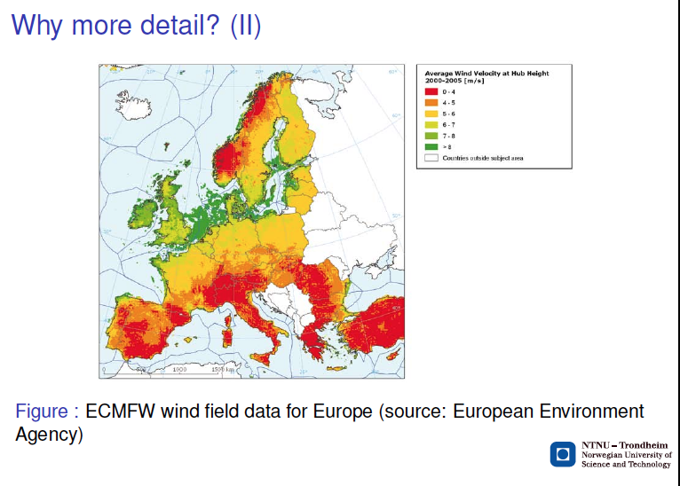
We need to model variations in wind, both the intermittent nature and geographically

Slide 12
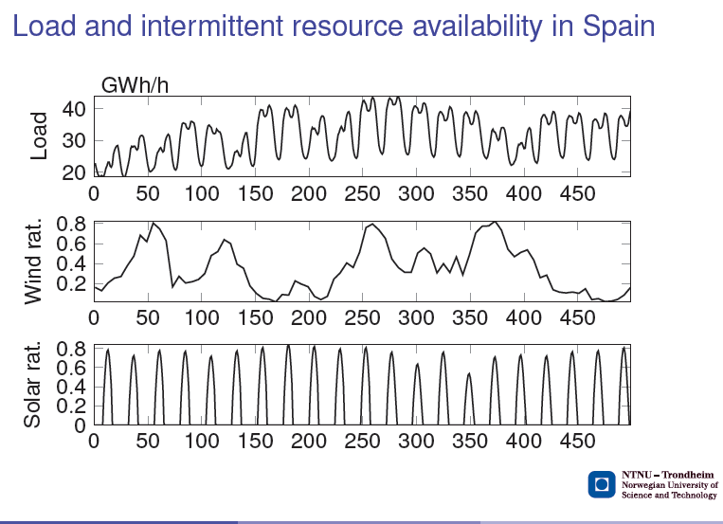

Slide 13
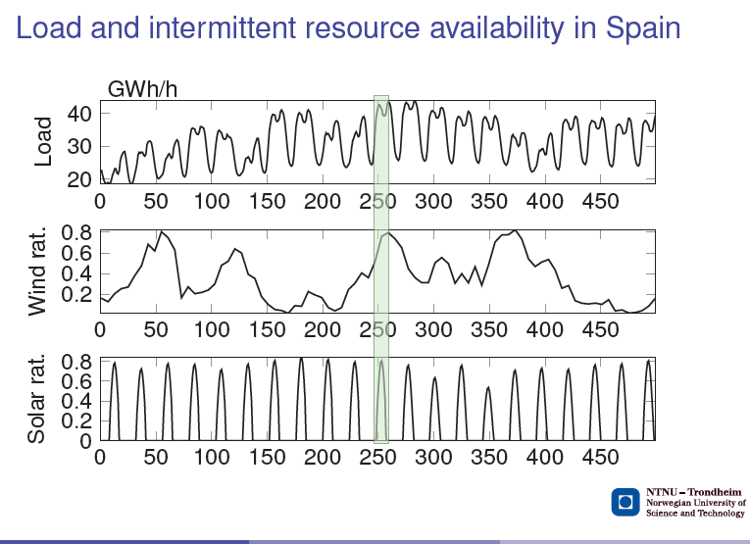

Slide 14
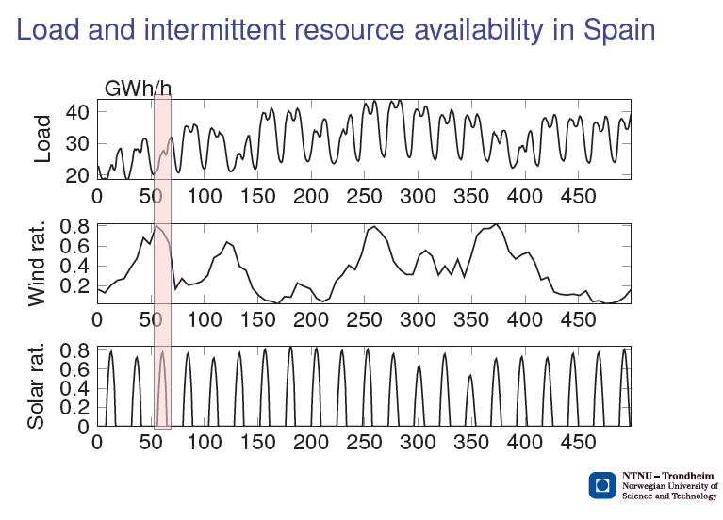

Slide 15
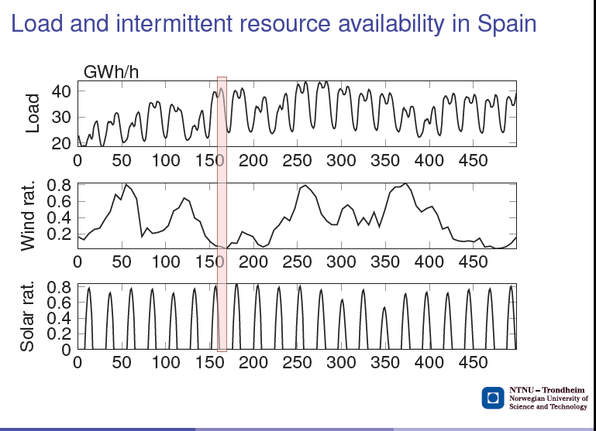

Slide 16
European policy scenarios
450 ppm stabilization scenario – A policy scenario where the atmospheric concentration of greenhouse gases is limited to 450 ppm CO₂-eq by the end of the century. Emission reduction is achieved by implementing a carbon price
Global 202020 scenario – A policy scenario inspired by the European 20-20-20 targets.Renewable portfolio standards, energy efficiency improvements and share of bio fuel in the transportation sector are set for different regions across the world.

Slide 17
European electricity demand(GCAM)

Slide 18
CO₂ prices

Slide 19
Installert kapasitet i Europa kraftmarkedet i 2050

Slide 20
NORWEGIAN ENERGY AND CLIMATE POLICY
The climate settlement (Klimaforliket) from the Norwegian parliament (2008 og 2012) proposes to reduce the Norwegian CO₂ emissions to 45-47 mill. tonns in 2020 and two thirds nationally.
Norwegian emissions were 52.7 mill. tonn CO₂-equivalents in 2013. The climate settlement proposes to reduce the norwegian emissions to 45-47 mill. tonn in 2020. In this, there is a self-imposed ambition that 2/3 of the reductions should be taken nationally.
The Norwegian environment agency estimates that we have to cut 7.5 mill. tonns before 2020 to reach this goal.

Slide 21
International obligations
An obligation for Norway to reach a given renewable energy share of 67.5% of the total energy consumption by 2020 (Fornybardirektivet).
Aa obligation to cut our yearly CO₂ emissions in 2020 with 30% compared with the1990 level. (Kyoto Protocol)
This can happen with cuts in Norway, by buying international carbon credits or by contributions to international projects.
Norwegian climate policy is by politcal deicision linked to EU climate policy
In order to meet obligations in the Paris agreement
Expects reductons in non-quota sector of 40%
How much at home?

Slide 22
Norwegian renewable energy
Should we build out hydro power and wind power in large scales?
How will cables abroad influence the conditions of Norwegian industry?
How will other Norwegian energy demand develop? (energy efficiency, electrification)?
What kind of technology choices will Europe make and how will this influence the need for Norwegian flexible water power and natural gas?
Will Europa phase out nuclear power, or will some of the countries that have planned this, change their minds?

Slide 23
New infrastructure in 2050 - 202020

Slide 24
New infrastructure in 2050 - 450

Slide 25
New Infrastructure in 2050- 650 ppm

Slide 26
Challenge
Today, the costs of new infrastructure for distribution and transmission are payed by the consumers.
Motivated by price stability and energy security
.
Uncertain if this is acceptable when the development is commercial
To support the European system
.

Slide 27
Subsidies – Green certificates
El- certificates for the production that your new construction contribute with to the market.
Demands that the sellers of electricity buy green certificates corresponding to a set amount of their power sale.
The power seller’s costs of buying certificats is added to the price that the customer has to pay.
Green certificates therfore function as a consumer tax and as a subsidy to the producers that can sell certificates.
In Norway and Sweeden the goal is to produce 26.4 TWh of renewable power yearly by 2020.
Ordningen medfører at 13.2 TWh ny produksjon av fornybar kraft godskrives Norge, og vil derfor bidra til at Norge når sine forpliktelser overfor EU om at fornybar andelen dekker 67,5 % av totalt energikonsum.

Slide 28
Effect on climate gas emissions
Regarding climate gas reduction, the effect in unclear. The regime comes in addition to EU ETS that allready covers the power sector.
The Certificate system does not influence total emissions in sectors that are not included in the EU ETS.
At the side, the more renewable energy available in the market, the stronger is the pressure on electricity producers using fossile fuel.
The certificate system contributes therefore to a long-term restructuring of the European power sector.

Slide 29
Norwegian climate policy
Some of the questions that politicians have to answer about Norwegian climate policy are:
How much shall we cut the Norwegian climate gas emissions before 2030?
How much of these cuts shall be taken in Norway?
What should be Norway’s long-term climate policy towards 2050?
The «luxuary problem» of our politicians will be how we shall address the climate challenges and at the same time predispose the natural resources to create values in the society.

Slide 30
Local versus global emissions
Local and global effects of the measures.
Carbon leak: Norway cutting emissions of 1 million tonn does not mean that the global emission cut will be the same.
Many will say that even if you reach local emission reduction by closing Norwegian industry, the global effect will be zero or negatvie since the good anyways will be produced somewhere.
Most of EU’s climate policy measures have therefore, totally or in part, protected competitive industry and sectors where you’re afraid of carbon leak.

Slide 31
Electrification of transport
50% of energy use in road transport emission free, equals reduced CO₂ emissions by 5-6 bill. tonns.
Global effect ?
Transport sector is not a part of the quota market in EU.
Emission reduction in Norway is in addition to the reductions Europe and Norway have planned within ETS.
The electricity used does not lead to increased emissions, since the power sector is inside the quota system.

Slide 32
Electrification of the shelf
Will cut Norwegian CO₂-emissions locally when water power is used in power production. Will this lead to real CO₂ cuts globally?
Mainland electricity will not change European emissions since both the power sector and oil extraction are subject to the quota system.
The for now unused gas will at some moment be transported to Europe. At the best, all gas will be used for electricity production and net emissions wil not increase because of the quota market.
The positive thing is that probably, more electricity will be produced because of teh gas, since the onshore gas turbines usually are more efficient. Influences profitability, not the emissions.

Slide 33

Energieffektivisering
EU sine nye mål er på 27% reduksjon for 2030.
I Norge stadig strengere krav, og støtte til energieffektivisering og sparing for eksempel gjennom Enova.
Kritikere hevder at med strøm som energibærer er energieffektivisering ikke effektivt klimatiltak.
Tiltak for energieffektivisering bør komme uten ytterligere støtte som en konsekvens av økt kvotepris.
Hvorfor har så både EU og Norge
målretta initiativ i denne retningen?

Slide 34

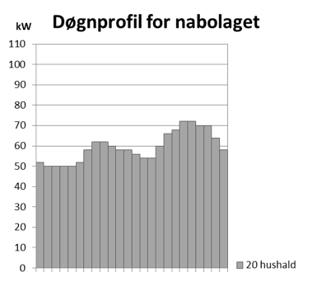
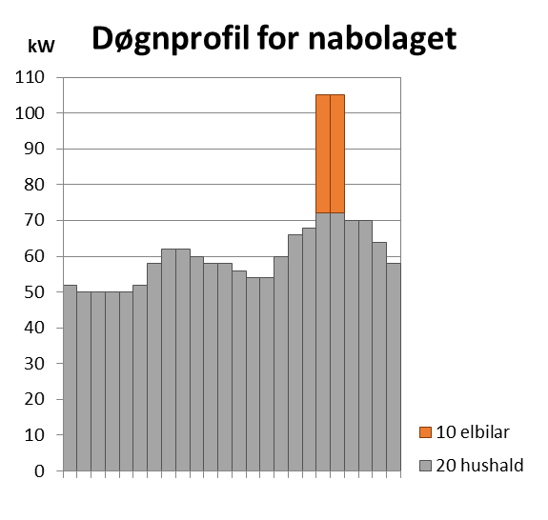























Case: ”Trouble in the neighbourhood”
TRØBBEL!

Slide 36
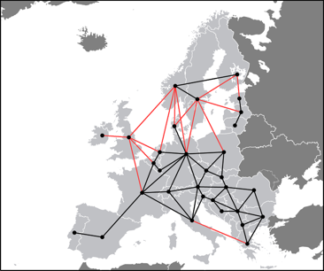
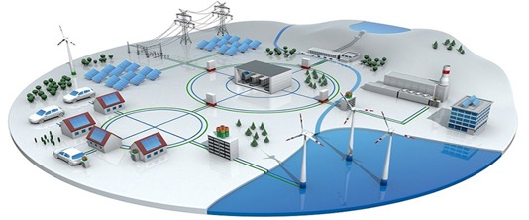
New drivers: Active consumers and distributed generation
Demand Response module in EMPIRE : in testing now
Multiscale geographical representation
Countries
Regions
Neigbourhoods
Kilde: 3M, Smart Grid: http://solutions.3m.com/wps/portal/3M/en_EU/SmartGrid/EU-Smart-Grid/
Notes:
Distributed generation
Generation (renewable) connected to the distribution system.
Rethinking system design: not just a question of moving electricity in bulk from large power plants to load centers
High shares of intermittent renewable generation.
Unpredictable generation
Needs to be balanced -> excess generation exported, deficit generation imported
Transmission and storage

Slide 37
Slides from Karen Byskov Lindberg

Slide 38
Slides from Karen Byskov Lindberg

Slide 39
Stimulating long-term restructuring
Energy Efficienct in builings and industry will be necessary in a society where 80% of climate gas emissions are removed.
Investments in buildings have a very long lifetime. Wrong investments in new buildings today have negative consequences for the possibility of reaching long-term climate goals.
Energy security reduces vulnerability in a power system with more renewable energy and higher top load.
Energy efficiency maked the industry more competitive – environmental friendly technology development.
Climate goals coordinated with goals of energy security and economic growth.

Slide 40
Recommendations
Anchor Norwegian climate poliy in EU’s climate policy. EU ETS as the most important measure.
For sectors that are not part of the EU ETS, prioritize measures that
Lead to real global reductions of CO₂ emission (f.ex. Electrification of the transport sector) and are not exposed to carbon leak.
Lead to a necessary restructuting of the society (f.ex. Energy efficiency)
Long-term agreements with neighbouring countries about renewable energy and how the flexibility can be used.
Long-term agreements and regulations around more flexible services connected to gas transportation and storage.
Research and demonstration that support Norwegian interests and at the same time are expected to have a climate effect-
For example CCS

